Slide 1
Welcome To Our EDA Project
CAPSTONE PROJECT - 1

Slide 2

Our Project is
*Global Terrorism Analysis*
👉 Team Name : Working With insights👈
Team Members Name :
➻ Nikita Verma.
➻ Tejaswini Sahu.
➻ Ashwini Kalamkar.
➻ Firaz Thakur.

Slide 3
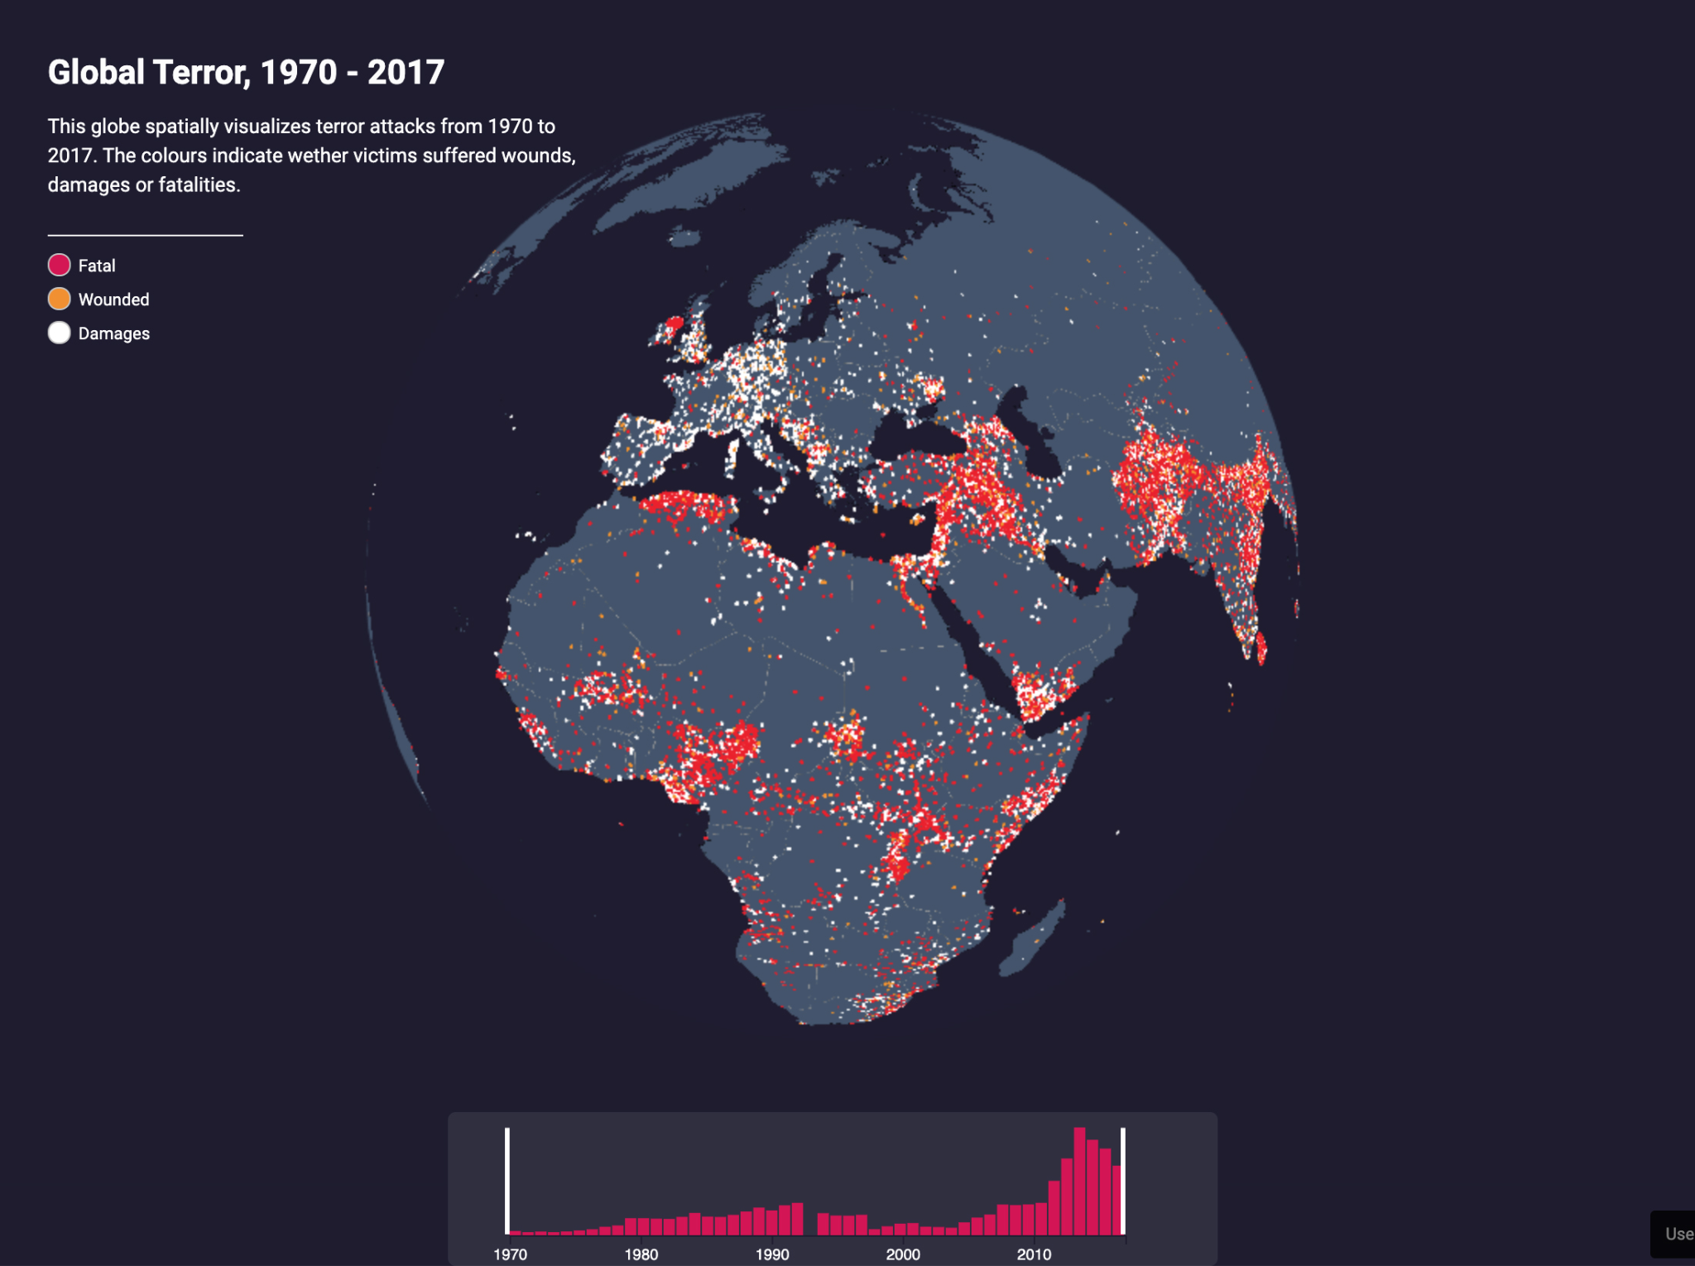

Slide 4

Global Terrorism Analysis
Defining problem Statement.
Importing libraries.
Descriptive Statistic.
Graphical Representation.
Observation.

Slide 5
Problem Statement
Data provided by the Global Terrorism Database.csv file is in unformatted manner, uneven data, and duplicate data and also some data columns it is irrelevant, because it’s a piled-up data coming from various different countries.
For doing the analysis on the data the data needs to be in correct format and well organized formed the main objective of the analysis is to obtain the meaning full information and facts from the given huge datasets by cleaning the datasets, doing a proper analysis , visualization and plotting the useful information into different graph and charts so that the trend and relationship between the various indicators on which the analysis is done can be understand easily.

Slide 6
DATA DICTIONARY
Year - Year of the attack
Month - Month of the attack
Day - Day of the attack
Region - Name of the region where the attack happened consists of values like East Asia,Western Europe, etc
Country – Name of the countries where the attack happened consists of values like Mexico, India, Iraq, Portugal
State – Name of the provinces/states where the attack happened which consists of values like Lattakia , Manipur
City – Name of the cities were attack happened consists of values like Baghdad, Mexico city, Imphal,
Latitude - Latitude of the location
Longitude- Longitude of the location
Location -Gives information of where the incident took place
Summary- Gives information about the attacks
Attack_type - Consists of categories like explosion, armed assault, assassination, kidnapping.
Target_type - Consists of categorical values like private citizens, military, police, government officials, transportation,education, religious institution, airports, etc
Gang_name - Organization that claimed responsibility of an attack
Weapon_type - Type of weapon used in the attack. Weapon Type 1 contains values like firearms, explosives, melee, vehicles etc.
Killed - Number of people killed in any event.
Wounded - Number of people wounded in any event.

Slide 7
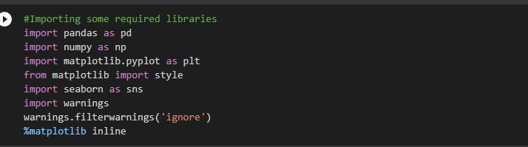
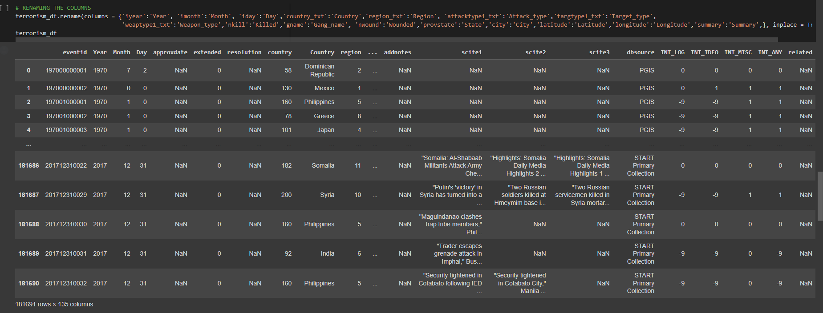

Slide 8

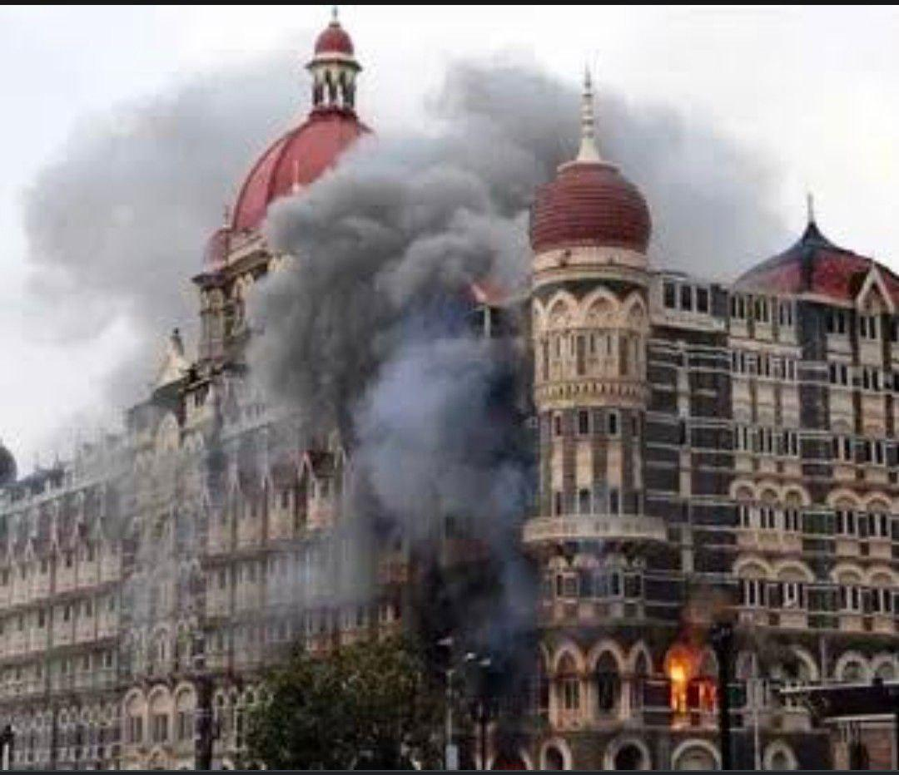
Global Terrorism
Terrorisms direct affected the safety of citizens.
Terrorism attacks affected on regions,country,cities and it creates bad impact on our countries and the international stability and prosperity.
The idea of this project is creat a “Global Terrorism Analysis” report through we can find the most affected regions,countries,city.
Which weapons they use ?
How many people kills,wound in terrorist activity?
We distribute whole analysis into four parts and lastly we put our observation.

Slide 9
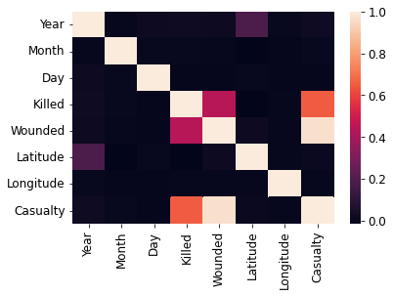
⭆HEAT MAP ⭅
Heatmap is used to show relationships between two variables.
➼ Some data part of heat map is having positive correlation.
➼ Some data part of heat map is having negative correlation.
➼ Some data part of heat map is having zero correlation.
➼ But negative correlation showing very low data part of heat map.

Slide 10
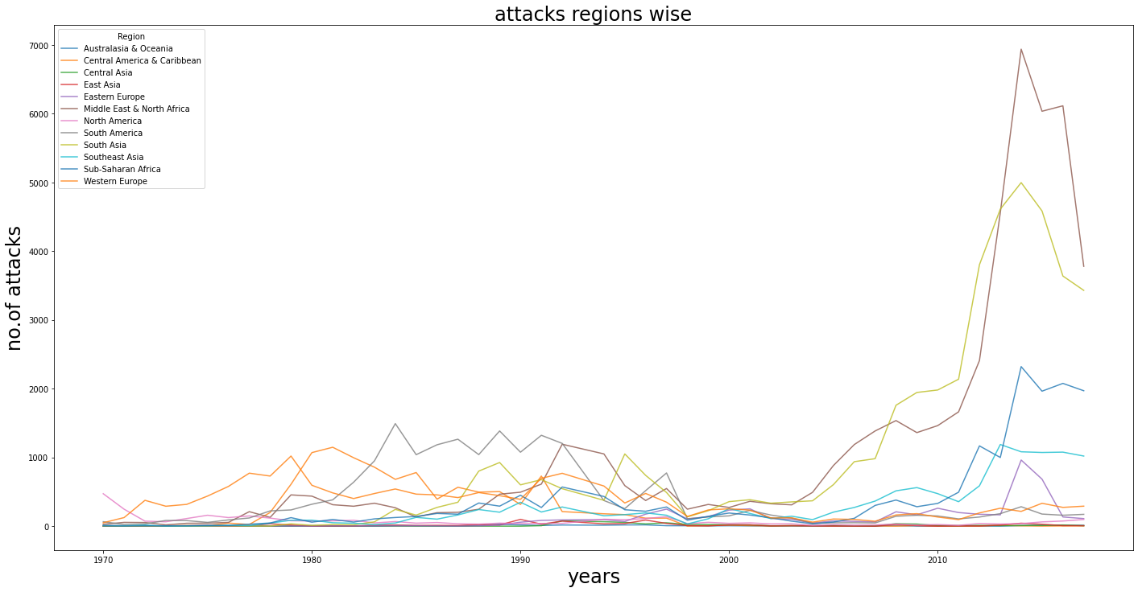
Regions wise terrorist attacks
➥ Regions wise terrorist attacks shown by the line chart.
➺A line chart consists of a horizontal lines i.e. x-axis and a vertical line i.e. y-axis to represent.
➺ through line chart we conclude that :
1] Maximum attacks done In Middle East and North Africa.
2] Minimum attacks done in East Asia.

Slide 11
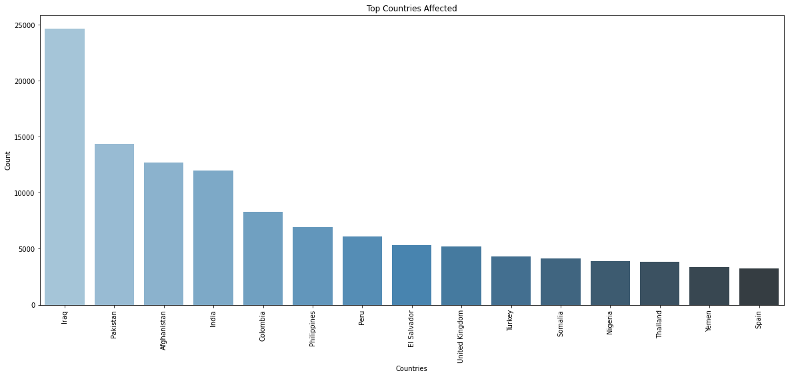
Country Wise Attacks
⏩Country wise attacks shown by the bar graph chart.
⟹ It consists of rectangles separated from each other with equal spaces.
⟹ For this bar graph we conclude that,
1] Maximum country wise attacks done in the Iraq country from 15 countries,then after that pakistan,afghanistan,India etc.
2]minimum countrywise attacks done in the Spain country from 15 countries.

Slide 12
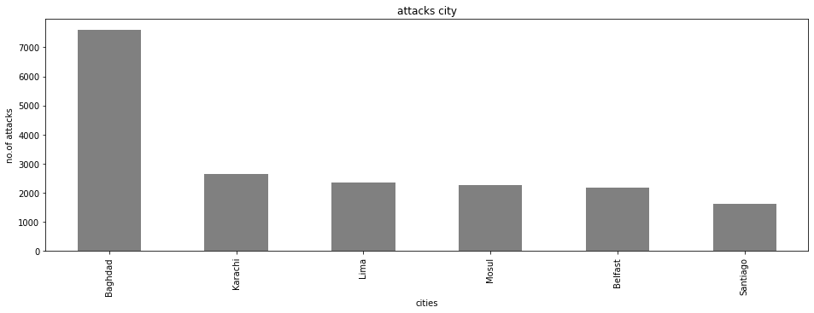
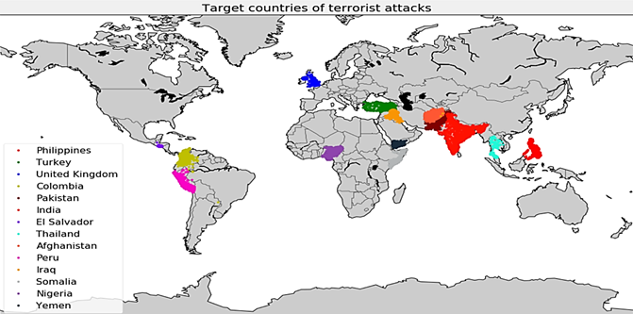
City Wise Attacks
➠city wise attacks shown by the bar graph.
➟ through this bar graph we conclude that :
A] Maximum city wise attacks
done by the baghdad city.
B] Minimum city wise attacks done by the baghdad city.

Slide 13
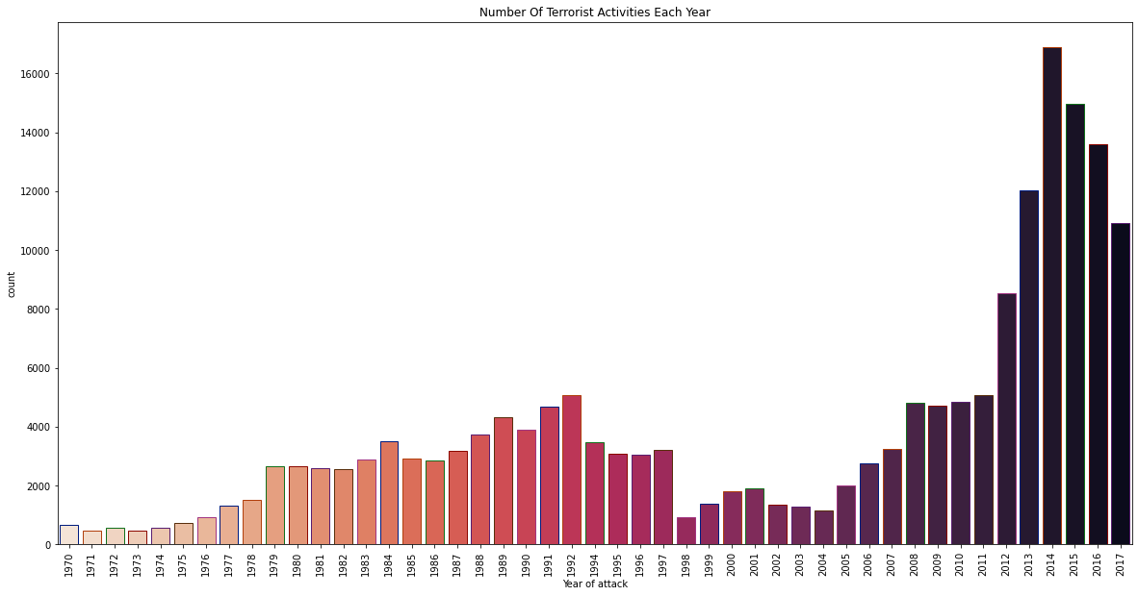
💫Year Wise Attacks💫
Year wise attacks shown by the bar graph.
Through this bar graph we conclude that:
In this graph we see that 1970 to 2014 increases number of attacks and after that 2014 to 2017 terrorism attacks decreases.
1. Maximum number of attacks occurs in 2014.
2. Minimum number of attacks occurs in 1971.

Slide 14
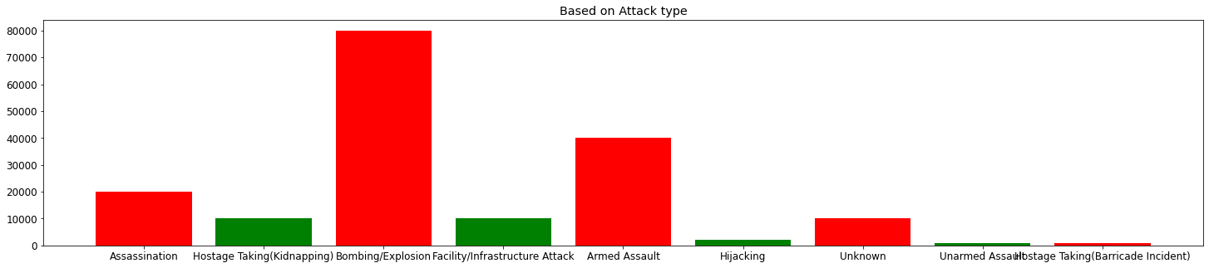
➢Based on attacks type
⏭based on attacks type shown by bar graph.
⏭through this graph we conclude that :
Most of the attacks were by either Bombing or Explosion.

Slide 15
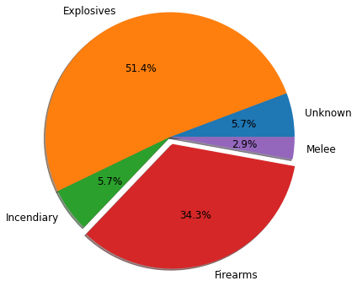
Based On Weapons Type
Based on weapons type shown by pie chart.
A pie chart is a type of graph that represents the data in the circular graph.
Through this pie chart we conclude that :
1] An Explosives (51.4%) type of weapons were most used in terrorist attacks.
2] The Melee (2.9%) type of weapons were least used in terrorist attacks.

Slide 16
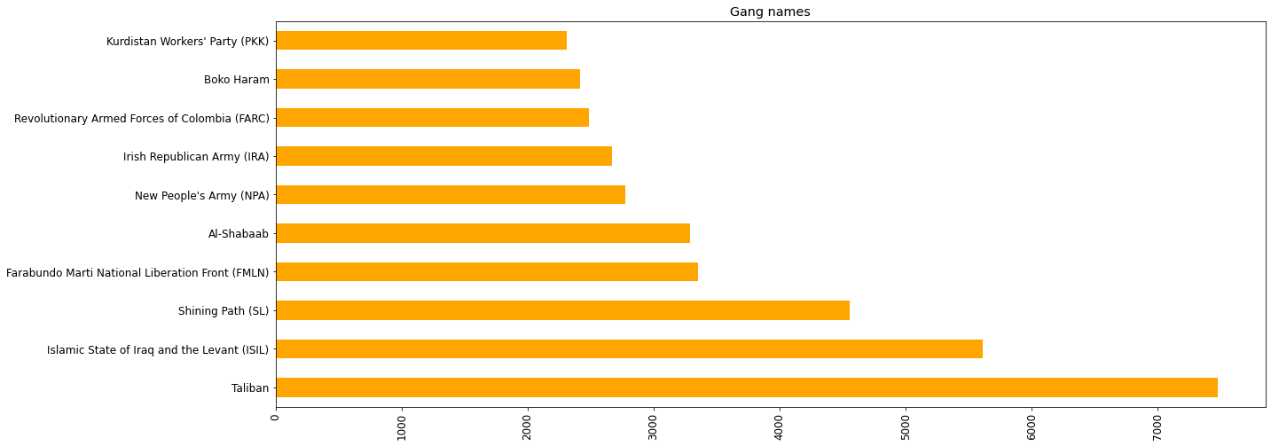
Gang Names :
1] Taliban is responsible for more than 7000 attacks.
2] It is the most dangerous gang.

Slide 17
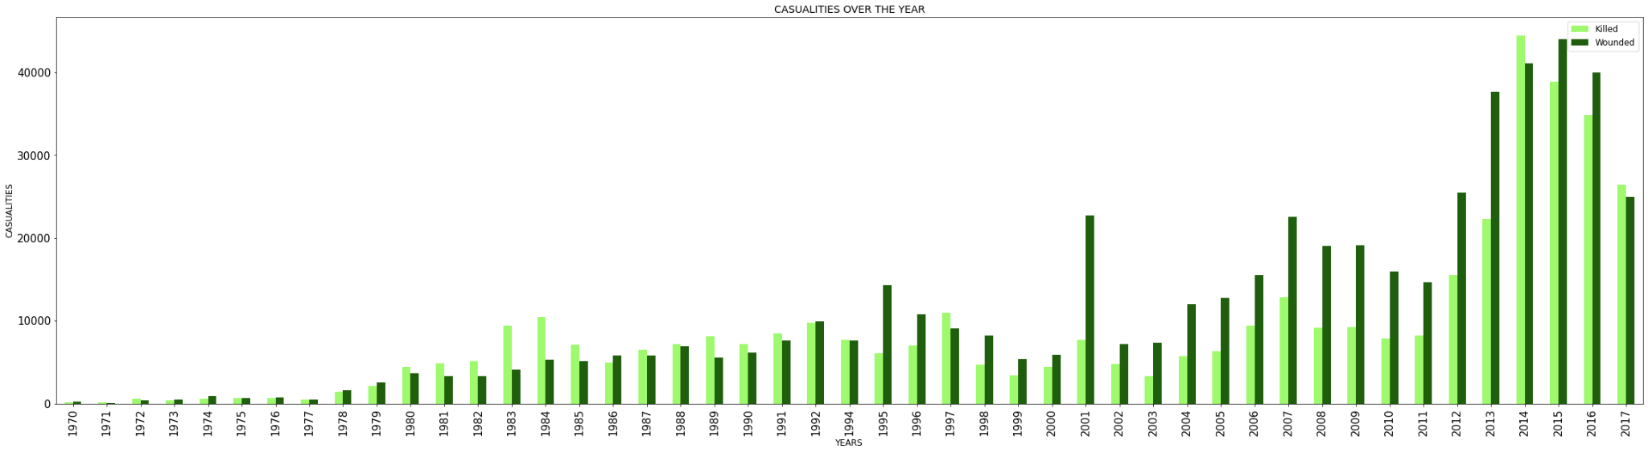
➥Total Casualties(kill and wound)in each year
Maximum casualty occurs in 2014 .
Less casualty occurs in 1970 .
1970 to 2014 causality has increased.

Slide 18
Observations
For our study we observed following insights:
Maximum attacks done In Middle East and North Africa.
Minimum attacks done in East Asia.
Maximum country wise attacks done in the Iraq country from 15 countries,then after that pakistan,afghanistan,India etc.
Minimum countrywise attacks done in the Spain country from 15 countries.
Maximum city wise attacks
done by the baghdad city.
Minimum city wise attacks done by the baghdad city.
Maximum number of attacks occurs in 2014.
Minimum number of attacks occurs in 1971.
Most of the attacks were by either Bombing or Explosion.
An Explosives (51.4%) type of weapons were most used in terrorist attacks.
The Melee (2.9%) type of weapons were least used in terrorist attacks.
Taliban is responsible for more than 7000 attacks.
It is the most dangerous gang.
Maximum casualty occurs in 2014 .
Less casualty occurs in 1970 .
1970 to 2014 causality has increased.

Slide 19



Slide 20


Slide 21


